Slide 1

Computer Systems for AI-inspired Cloud: Theory & Lab.
Fall 2018
Dr. JongWon Kim
(jongwon@gist.ac.kr)
Networked Computing Systems Lab., School of Electrical Engineering and Computer Science, GIST

Slide 2
기존 국문제목: 클라우드, AI기반 소프트웨어 중심의 정보통신
수정 영문제목:
Computer Systems for AI-inspired Cloud: Theory & Lab.
수정 영문제목:
AI 기반 클라우드를 위한 컴퓨터 시스템: 이론 및 실습

Slide 3
Contents: Theory
Chapter 1. What is Computer System?
Chapter 2. Computer System & OS Software
Chapter 3. Computer System: Virtualization & Containers
Chapter 4. Computer System: Cloud-native Computing
Chapter 5. Computer System: Clusters for HPC/BigData & AI
Chapter 6. Computer Systems for Cloud Data Center and SDI
Chapter 7. Computer System & SmartX Abstraction

Slide 4
Contents: Labs
Lab #0: Overview Lab
Lab #1: Box Lab
Lab #2: Inter-Connect Lab
Lab #3: Tower Lab
Lab #4: IoT Lab
Lab #5: Cluster Lab
Lab #6: Analytics Lab

Slide 5
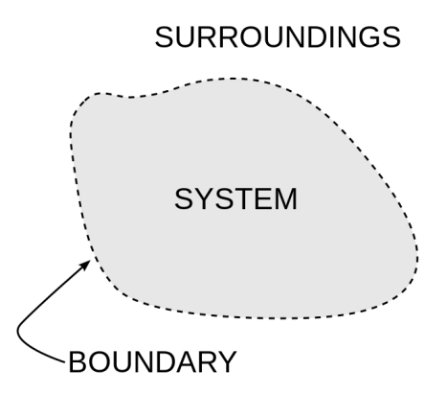

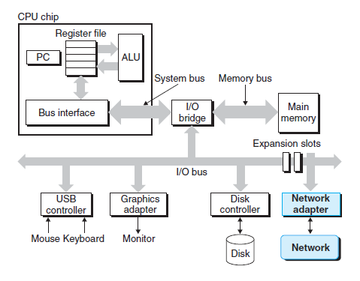
Chapter 1: What is Computer System?

Slide 6

Chapter Keywords
Storage
Compute
Box
Networking

Slide 7
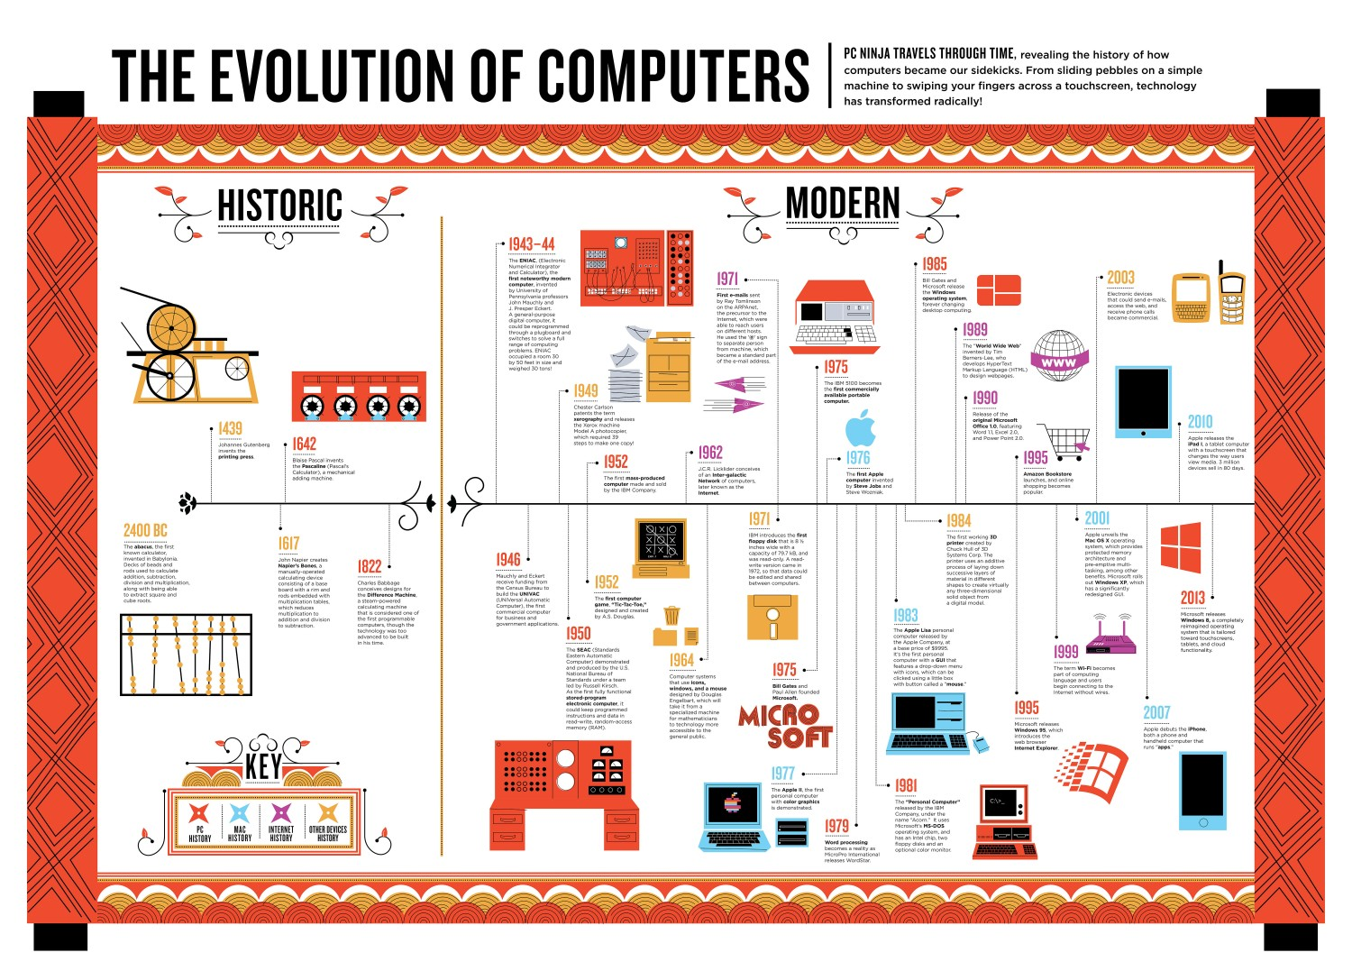
Check https://www.livescience.com/20718-computer-history.html
https://visual.ly/community/infographic/computers/evolution-computers

Slide 8
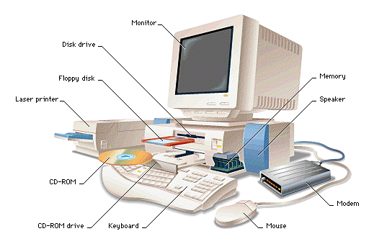
Computer System: Definition
Computer: an electronic device for storing and processing data, typically in binary form, according to instructions given to it in a variable program.
System: a set of interacting or interdependent components forming an integrated whole
http://csapp.cs.cmu.edu/
https://slideplayer.com/slide/8830994/

Slide 9

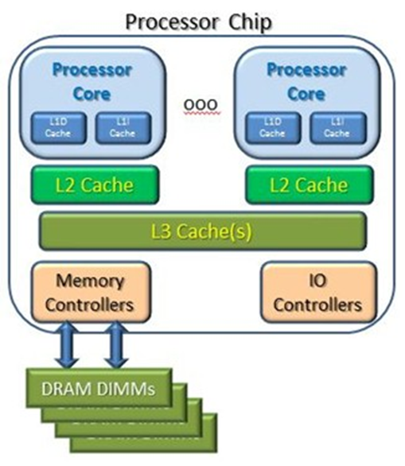

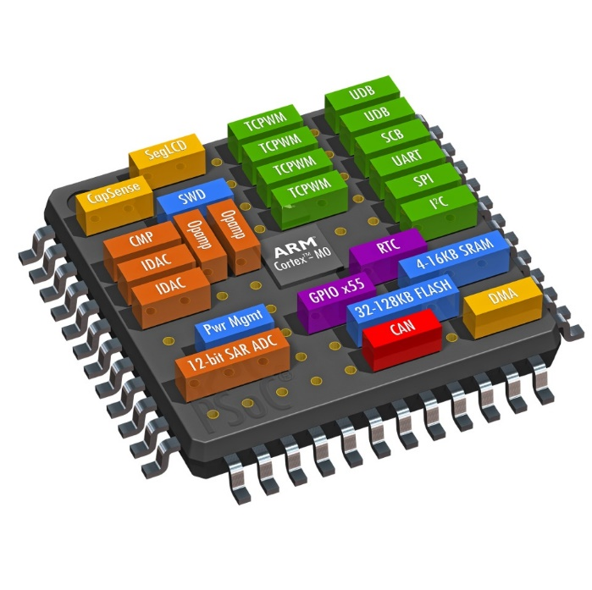
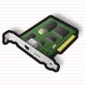
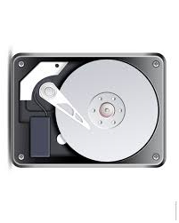
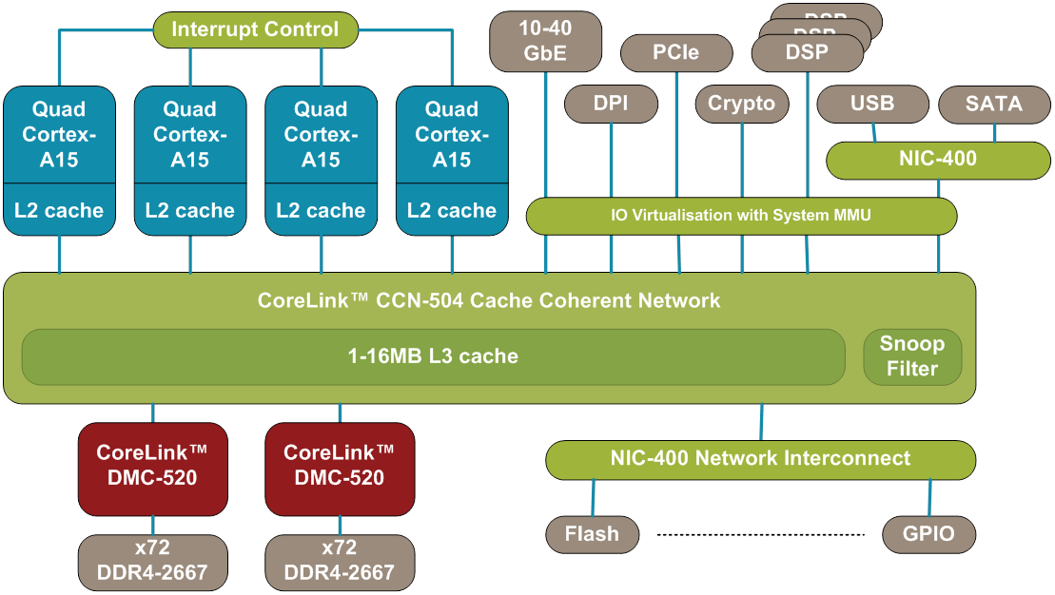
Evolution of Computer System (Chip)
https://medium.com/computing-technology-with-it-fundamentals/system-hardware-component-processor-fd1e58d6dfb2
SOC Chip (ARM Cortex + Corelink)
https://community.arm.com/processors/b/blog/posts/coherent-interconnect-technology-supports-exponential-data-flow-growth

Slide 10
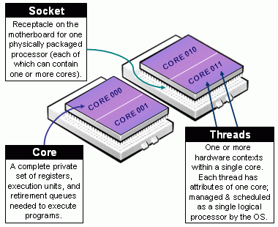
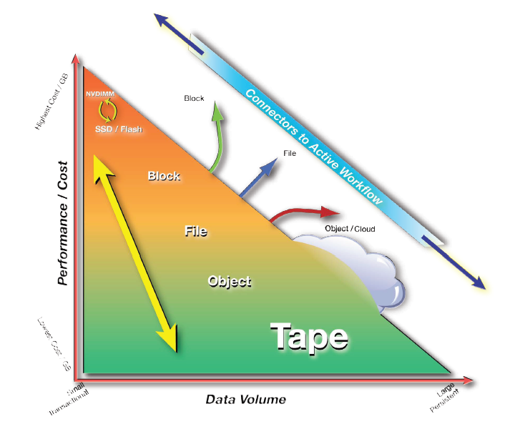
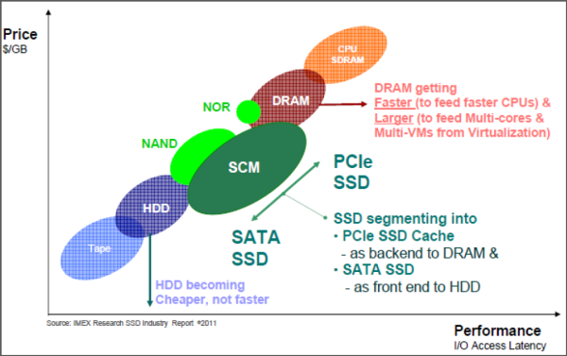
Major Components of Computer Systems
Compute
CPU & Memory
Storage
Network
https://slurm.schedmd.com/mc_support.html
Memory/Storage Hierarchy
추적 불가
https://www.semanticscholar.org/paper/Optimizations-of-Management-Algorithms-for-Memory-Oren/2799edf40be793a6c7b86b391270014442191cd7

Slide 11
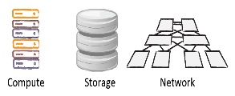

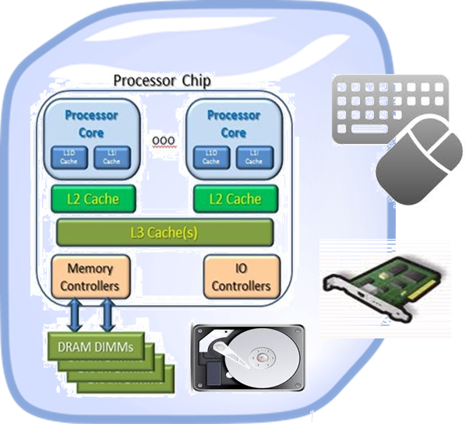
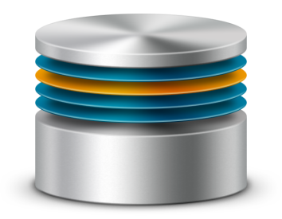
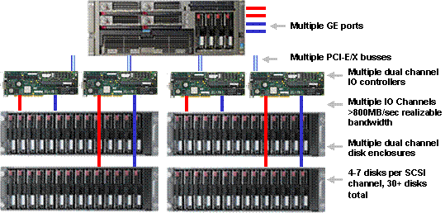
Diversity of Computer Systems ➔➔ Box
Networking Box
Compute Box
Storage Box
http://www.sql-server-performance.com/2006/system-storage-configuration/

Slide 12
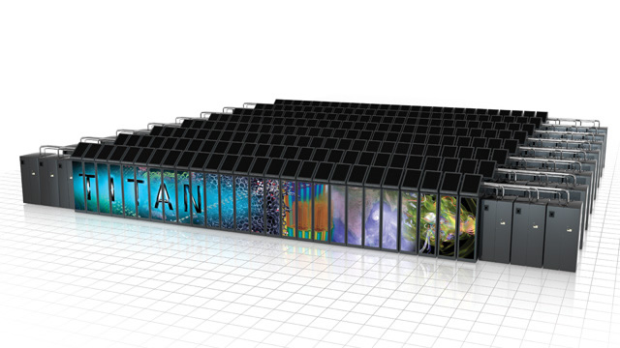
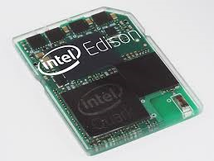

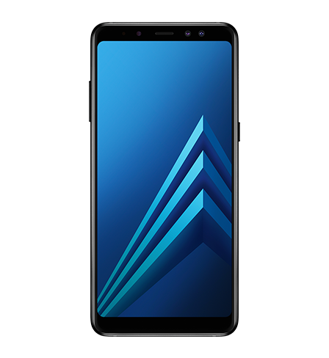
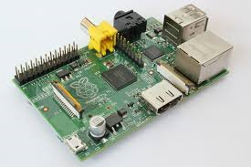


Compute Box: Computers & Computer (Server) Clusters
https://www.engadget.com/2014/03/31/intel-sd-card-sized-edison-change/
https://www.clubic.com/pro/it-business/calcul-distribue/actualite-601866-supercalculateur-tianhe-2-premier-top500.html
https://commons.wikimedia.org/wiki/File:Arduino_Ethernet_Board.jpg
https://gl.wikipedia.org/wiki/Raspberry_Pi
https://hatewait.ru/product/samsung_galaxy_a8_2018_black.aspx

Slide 13
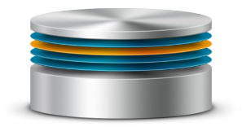
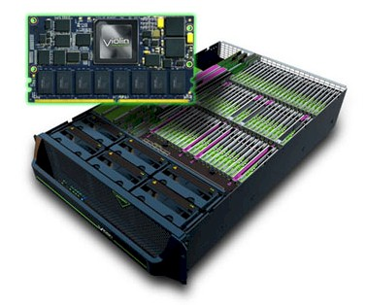
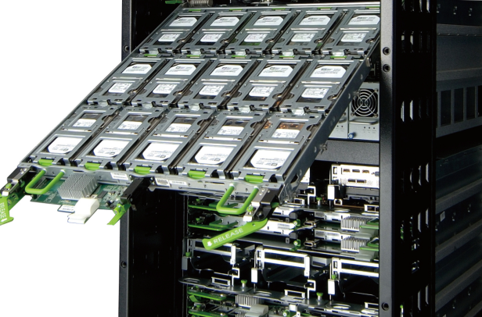

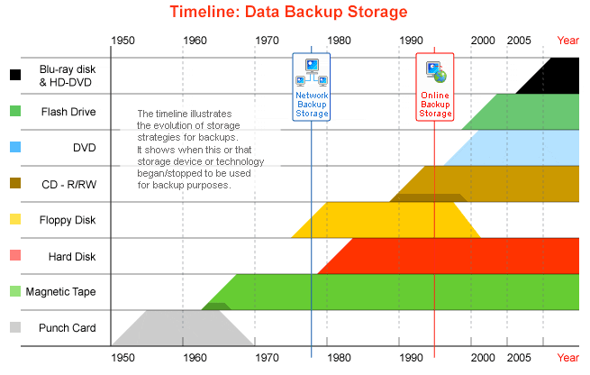
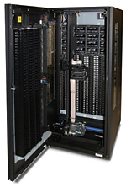

Storage Box: Storage Servers
http://www.bigfixtech.com/
http://www.nsdbi.co.jp/news/201310-002.html
http://files.gpfsug.org/presentations/2018/Singapore/Frank_Kramer_IBM-DataManagement-for-ADAS-Scale-UserGroup-SIN-032018.pdf/
http://www.backuphistory.com/

Slide 14

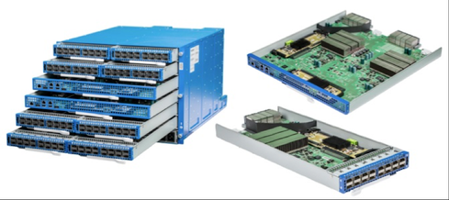
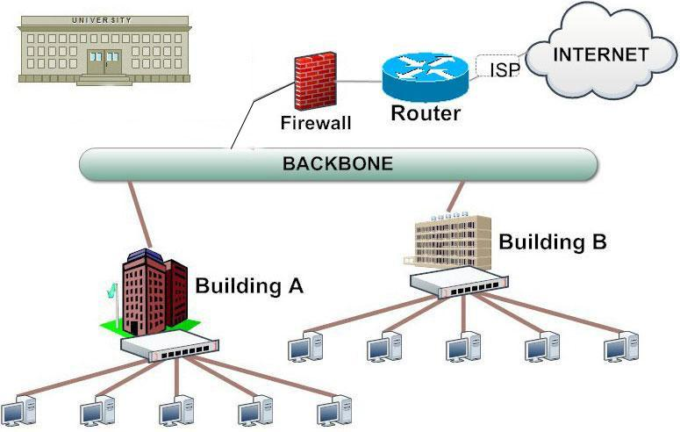

Networking Box: Switches & Routers
Router
https://www.jianshu.com/p/5bf4213d4f0a
Switch
http://surroundnet.com/wifi-campus.pdf

Slide 15
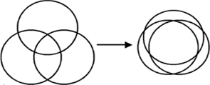
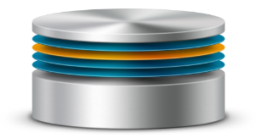
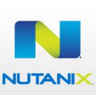
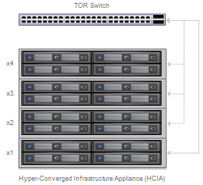
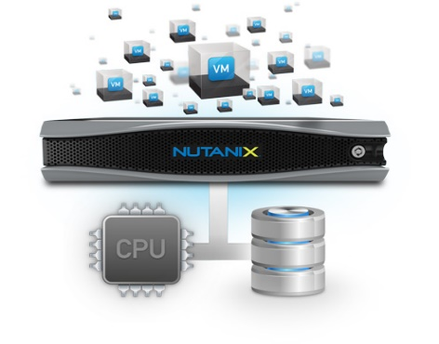

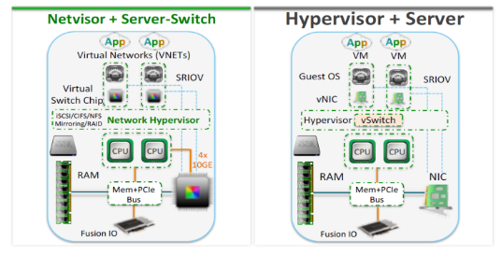

Futuristic Box: Hyper-Converged Infrastructure
http://www.bytelife.com/blog/software-defined-andmekeskus-pariselt/
http://www.wooditwork.com/2014/08/25/vmware-marvin-comes-alive-evorail-hyper-converged-infrastructure-appliance/
https://www.enterprisetech.com/2014/02/10/startup-slashes-latencies-server-switch-hybrid/

Slide 16
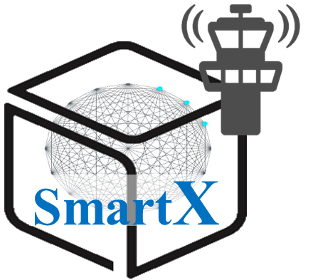
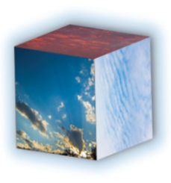
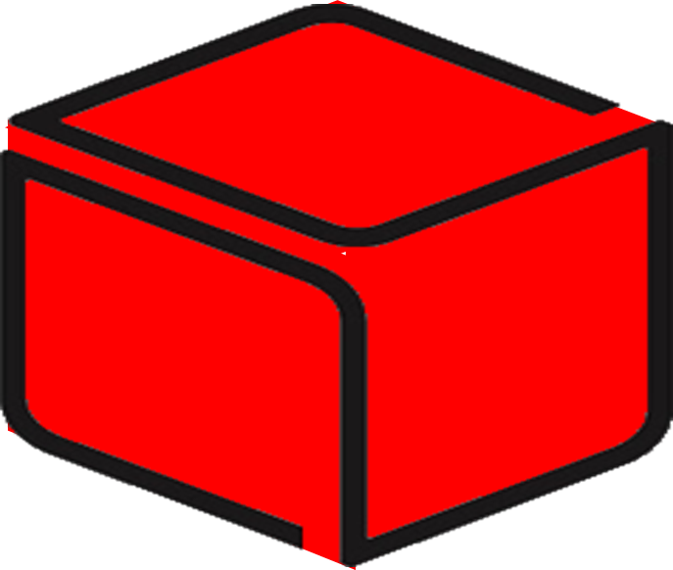


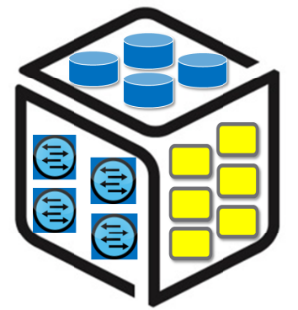

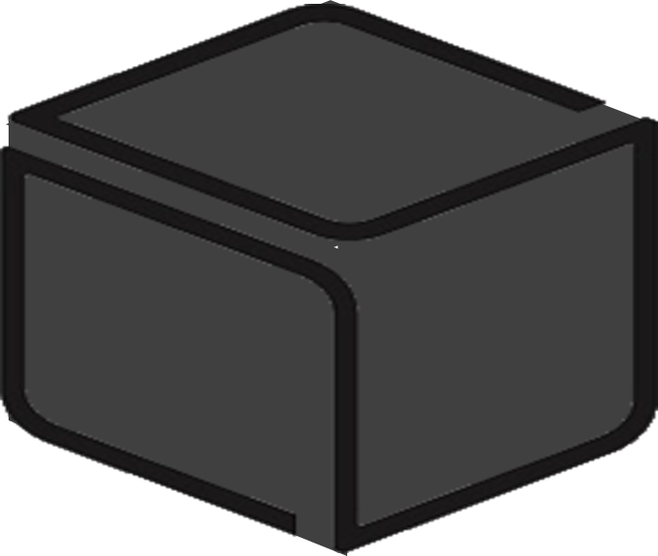
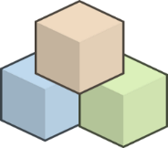


Multiple Box Abstractions: Black/Brown/White and SmartX Boxes
Brown/Brite Box
SmartX Box
Virtualized Box
White Box
Black Box
Hyper-converged Box

Slide 17
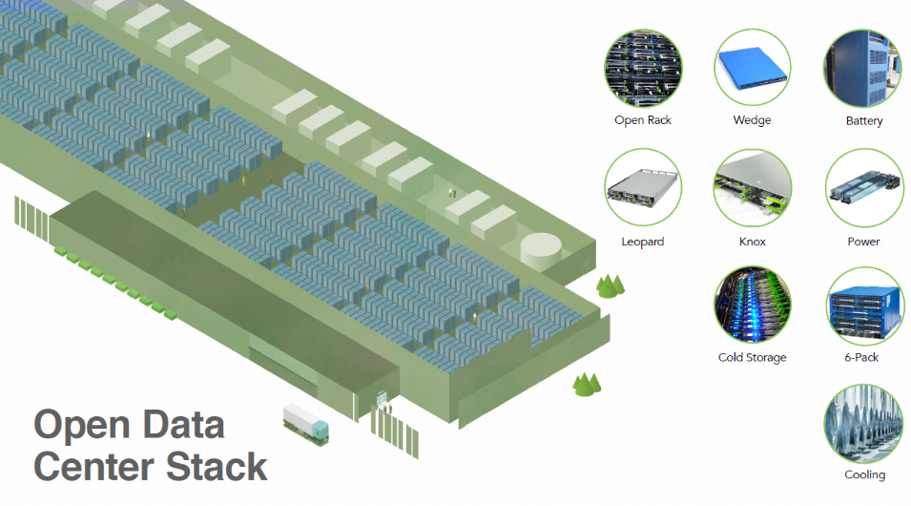
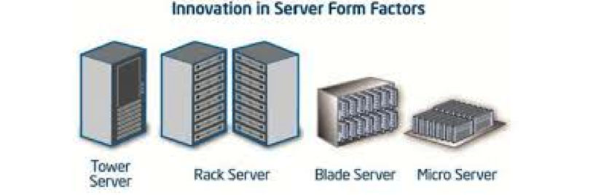

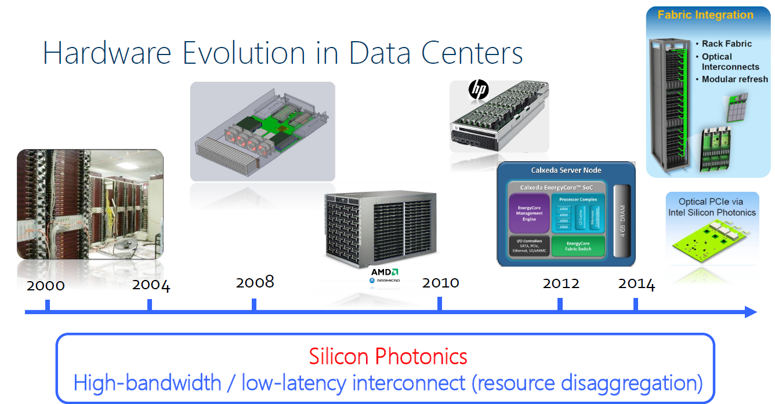
Converged/Disaggregated Boxes in Data Centers
https://internetofthingsagenda.techtarget.com/definition/microserver
Open-Source Hardware
Rack Scale Computing

Slide 18
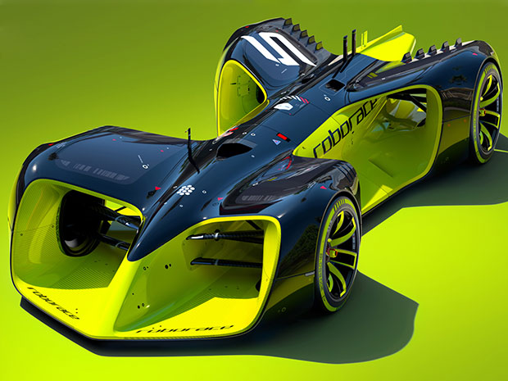

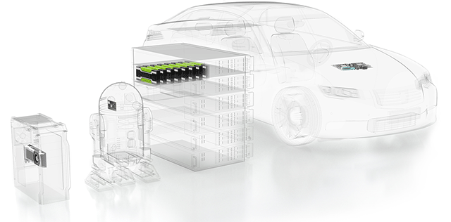
Computer Systems Everywhere
http://poe.goha.ru/news/99/2016-04-01%2014:00:18
RoboRace
http://nvidia.com

Slide 19
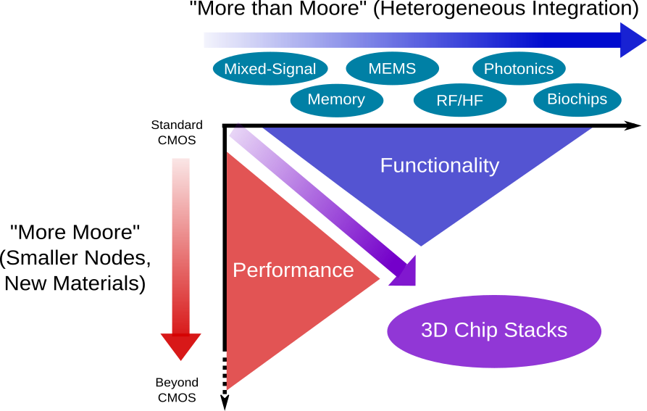
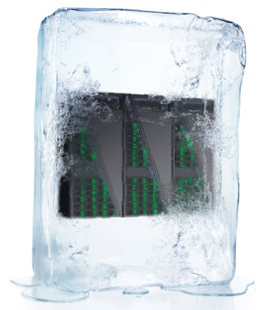
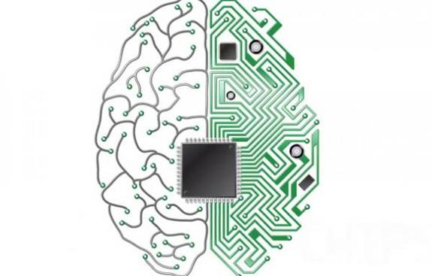
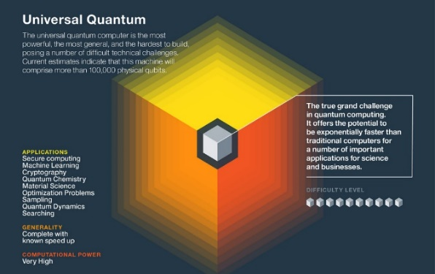
Future of Compute Boxes
Neuromorphic
Cryogenic
Notes:
https://cra.org/crn/2016/09/whistling-past-graveyard-end-moores-law-means-computing/differing-levels-of-disruption-in-computing/
https://www.3dincites.com/2016/05/challenges-and-solutions-for-eda-of-3d-chip-stacks/moore/
https://www.google.co.kr/search?sa=G&hl=ko&q=%EC%BB%B4%ED%93%A8%ED%84%B0&tbm=isch&tbs=simg:CAQSlQEJVLtQy0z-Qu4aiQELEKjU2AQaAggVDAsQsIynCBpiCmAIAxIojBLnBYsSkgGJEokBjAGFAsAFrAedNpw2tSjENfk27ifBNfo2kDXRNRowKEOl7zCsVBykcJ1hOZqqxsXz2tQfsswu9UFMZxKc3MF9hcBeEXHnv7cCrP95oM3ZIAQMCxCOrv4IGgoKCAgBEgQ4_1QgHDA&ved=0ahUKEwjuqeuev-XeAhWJa7wKHbUuDUAQwg4IJygA&biw=878&bih=968#imgrc=Gw8Wjf3N2footM:
http://www.fsgamer.com/la-computacion-cognitiva-en-los-videojuegos.html
http://www.visualcapitalist.com/three-types-quantum-computers/

Slide 20


Thank you!
Gwangju Institute of Science & Technology
Send Inquiry to jongwon@gist.ac.kr
http://nm.gist.ac.kr

Slide 21

Chapter 2: Computer System & OS Software

Slide 22
Chapter Keywords
Operating System (OS)
Kernel
Linux

Slide 23

Computer System: Inter-Connected Functions inside/across Boxes/Sites
Resources – Workloads - Services
Functions
Box
Site
Inter-Connect

Slide 24
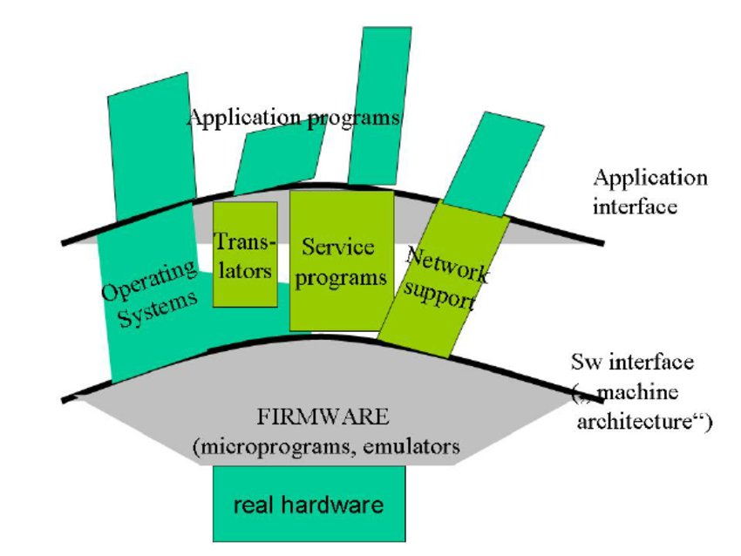
Computer System: Hardware & Software
Hardware
vs
Software (Firmware, Operating System (OS), Middleware, Application, …)
https://www.researchgate.net/figure/The-layers-of-a-computer-system_fig2_290352853
Middleware ("software glue“): Computer software that provides services to software applications beyond those available from OS; Helps to communicate and manage data of distributed systems.
Firmware: A block of program instructions for specific purposes, recorded in non-volatile memory, which establishes the lowest level logic that controls the electronic circuits of a device of any type; Helps to control the functionality of the hardware or electronic devices.

Slide 25
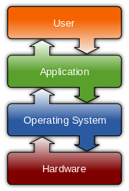

Computer System: Operating System (OS)
Operating System (OS): Software that manages computer hardware and software resources and provides common services for computer programs.
https://www.topsimages.com/images/utility-system-fe.html
https://tkjbinpressa.wordpress.com/2016/09/05/arsitektur-sistem-operasi/

Slide 26


Computer System: OS & Kernel
https://de.wikipedia.org/wiki/Datei:Priv_rings.svg
Kernel: a computer program that is the core of a computer's operating system, with complete control over everything in the system.
Supervisor mode / user mode
https://docs.apwg.org/reports/mobile/APWG_Mobile_Report_v1.9.pdf

Slide 27

History of Unix-like Operating Systems
[Video] How Linux is built https://youtu.be/yVpbFMhOAwE?list=PLAbMs_G4N5lWpQC2fDpv-hQhbCf-MPPQL
[Video] Linux Kernel Development, 1991-2015 https://youtu.be/5iFnzr73XXk

Slide 28



Linux OS Everywhere
http://www.linuxsc.net/linux/windows-domina-el-escritorio-pero-linux-gana-el-mundo
https://blog.netdevgroup.com/2016/11/linux-is-everywhere-infographic/

Slide 29


Linux Kernel Diagram

Slide 30

Computer System: Microcontroller Architecture
http://www.refreshnotes.com/2016/02/von-neumann-vs-harvard-architecture.html
Von Neumann Model | Harvard Model
Named after the mathematician and early computer scientist John Von Neumann. | Originated from “Harvard Mark I” a relay based computer.
Required only one memory for their instruction and data. | Required two memories for their instruction and data.
Design of the von Neumann architecture is simple. | Design of Harvard architecture is complicated.
Required only one bus for instruction and data. | Required separate bus for instruction and data.
Processor needs two clock cycles to complete an instruction. | Processor can complete an instruction in one cycle
Low performance as compared to Harvard architecture. | Easier to pipeline, so high performance can be achieve.
Cheaper. | Comparatively high cost.

Slide 31


Computer: CPU – RISC vs CISC
Intel x86: complex instruction set computing (CISC) architecture
ARM, MIPS: reduced instruction set computing (RISC) → low power consumption
https://csarassignment.wordpress.com/2013/05/02/risc-vs-cisc/
ARM:
A chips for high-performance application;
R chips for real-time processing;
M chips for micro-controllers.

Slide 32


OS & Compute: Socket/Core & Threads
추적 불가
http://www.hpc.lsu.edu/training/weekly-materials/2018-Fall/HPC_UserEnv_Fall_2018_session_1.pdf

Slide 33


OS & Compute: Threads/Processes
Threads contain only necessary information, such as a stack, a copy of the registers, program counter and any thread-specific data to allows them to be scheduled individually.
https://www.javaquery.com/2016/07/what-is-difference-between-process-and.html
https://randu.org/tutorials/threads/

Slide 34

Linux OS: I/O Stack
https://www.iconspng.com/image/39434/io-stack-of-the-linux-kernel

Slide 35



OS & Memory/Storage
https://tech.vccloud.vn/object-storage-luu-tru-doi-tuong-la-gi-khac-gi-voi-luu-tru-truyen-thong-20180702092808245.htm
Flash Memory ➔ SSD
https://nvmexpress.org/about/why-nvm-express/

Slide 36
Linux Kernel Networking: L2/L3/L4…
https://www.slideshare.net/ThomasGraf5/devconf-2014-kernel-networking-walkthrough
Packet Processing
TCP Processing
IP Processing

Slide 37




Linux OS: Boot Procedure
http://www.matsuura.com.br/2014/04/processo-de-inicializacao-do-linux.html
https://docplayer.es/4085195-Systemd-software-freedom-day-2015-alex-callejas.html
Lilo ➔➔GRUB (Grand Unified Bootloader)
https://www.thegeekdiary.com/centos-rhel-7-booting-process/
https://unix.stackexchange.com/questions/111237/how-does-linux-deal-with-a-separate-boot-partition

Slide 38
Thank you!
Gwangju Institute of Science & Technology
Send Inquiry to jongwon@gist.ac.kr
http://nm.gist.ac.kr

Slide 39

Chapter 3: Computer System Virtualization & Containers

Slide 40
Chapter Keywords
Virtualization
Virtual Machine
Hypervisor
Containers

Slide 41
p(Baremetal) + v(Virtual Machine) + c(Container) Harmonization
Hypervisor-based Virtualization
Applications
(c) Containerized Box/Function
(v) Virtual Machine Box/Function
(p) Physical Baremetal
Box/Function

Slide 42




Virtual Machines (VMs)
http://hesed.info/blog/virtuelle-maschine.abp
http://kuas1095108129.blogspot.com/

Slide 43


Hypervisor Type 1 & 2 for Virtualization
http://microstrong.pe.kr/wordpress/?cat=37

Slide 44


VMs (Functions) with Hypervisor-based Virtualization
추적 불가

Slide 45

Physical and Virtual Machines:
Inter-connection
https://earlybert.com/2013/08/15/is-het-virtuele-netwerk-een-uitbreiding-van-het-fysieke-of-juist-omgekeerd/

Slide 46

Virtualization for Compute/Network
Virtualization: Basic act of decoupling an infrastructure service from the physical assets on which that service operates.
Compute Virtualization
Network Virtualization
http://bradhedlund.com/2013/05/28/what-is-network-virtualization/

Slide 47
p(Baremetal) + v(Virtual Machine) + c(Container) Harmonization
Runtime-based Containerization
Applications
(c) Containerized Box/Function
(v) Virtual Machine Box/Function
(p) Physical Baremetal
Box/Function

Slide 48

Containers vs VMs Packaging workload tasks and Scaling …
http://www.internetpost.it/cloud-architettura-x86-futuro/

Slide 49





Docker: Light-weight Process (Application) Container
Docker Hub
Docker Engine
https://conf.phprs.com.br/slides/Palestra-Docker.pdf
https://ecs.victoria.ac.nz/foswiki/pub/Courses/NWEN406_2018T1/LectureSchedule/NWEN406-presentation-summary-10.pdf
https://www.cnblogs.com/lijuanhu321/archive/2018/07/15/9313159.html

Slide 50









Containers
HPC-targeted Containers
Virtual Machines
http://technodocbox.com/71051449-Windows/Singularity-for-gpu-and-deep-learning.html
Machine Containers
Process Containers
http://ju.outofmemory.cn/entry/337394
Traditional operations
Traditional operations
Mesos / Kubernetes / Swarm
Sandbox-isolated
Containers
KVM
LXD
Docker + RunC / Rkt
Host Linux Filesystem
Cluster-in-a-box: Deploying Kubernetes with LXD & Machine Containers @ KubeCon 2017

Slide 51


OCI (Open Container Initiative)
To encapsulate a software component and all of its dependencies in a format that is self-describing and portable, so that any compliant runtime can run it without extra dependencies, regardless of the underlying machine and contents of the container.
https://www.slideshare.net/caniszczyk/cloud-native-landscape-cncf-and-oci

Slide 52





CRI(Container Runtime Interface): Containerd, rkt, CRI-O, …
Containerd: An industry-standard container runtime with an emphasis on simplicity, robustness and portability.
rkt: CRI designed for composability, security, and speed.
CRI-O: OCI-based implementation of Kubernetes CRI; vs cri-containerd.
https://kubernetes.io/blog/2018/05/24/kubernetes-containerd-integration-goes-ga/

Slide 53

p+v+c Harmonized Networking
추적 불가
추적 불가
p(Baremetal) + v(Virtual Machine) + c(Container) Harmonization
추적 불가

Slide 54
Thank you!
Gwangju Institute of Science & Technology
Send Inquiry to jongwon@gist.ac.kr
http://nm.gist.ac.kr

Slide 55

Chapter 4: Computer System Cloud-native Computing

Slide 56
Chapter Keywords
Serverless Computing
Cloud-native Computing
Orchestration
Open Interface

Slide 57




From Baremetal to Containers / Serverless
Monolithic Apps
N-tier Apps
Micro-services
Nano-services
Cloud (VMs, BM, …)
Baremetal
Boxes
Serverless
(functions)
Virtual Machines
Containers
(Docker, Singularity, LXD, …)
Notes:
A unikernel is a specialised, single address space machine image constructed by using library operating systems.^{[1][2]} A developer selects, from a modular stack, the minimal set of libraries which correspond to the OS constructs required for their application to run. These libraries are then compiled with the application and configuration code to build sealed, fixed-purpose images (unikernels) which run directly on a hypervisor or hardwarewithout an intervening OS such as Linux or Windows.

Slide 58



unikernel
A specialized, single address space machine image constructed by using library operating systems.
https://manuzhang.github.io/2016/01/28/unikernel.html
https://www.industrynetwork.nl/tag/security/
추적 불가
Notes:
Unikernel: a specialised, single address space machine image constructed by using library operating systems. A developer selects, from a modular stack, the minimal set of libraries which correspond to the OS constructs required for their application to run. These libraries are then compiled with the application and configuration code to build sealed, fixed-purpose images (unikernels) which run directly on a hypervisor or hardware without an intervening OS such as Linux or Windows.

Slide 59











Serverless (FaaS) computing
Event-driven, Continuous-scaled,
Pay-by-use
추적 불가
Apache OpenWhisk
https://www.researchgate.net/publication/319234373_Status_of_Serverless_Computing_and_Function-as-a-ServiceFaaS_in_Industry_and_Research
https://www.smoothterminal.com/articles/exploding-rails-knative-k8s-serverless-elixir-qol-js-fundamentals-stable-apis
http://wxec.info/knative-istio.html
https://hackernoon.com/creating-a-serverless-python-api-using-aws-lambda-chalice-d321dc43ce2
https://medium.com/horizon-four/lets-talk-about-serverless-que-tal-na-azure-bc307f11952a
Knative
AWS Lambda
Azure Functions
https://seosait-yis.ru/case-instagram-cleaning
https://blog.mazarin.lk/serverless-architecture-aws-lambda/
Google Cloud Functions
Notes:
Unikernel: a specialised, single address space machine image constructed by using library operating systems. A developer selects, from a modular stack, the minimal set of libraries which correspond to the OS constructs required for their application to run. These libraries are then compiled with the application and configuration code to build sealed, fixed-purpose images (unikernels) which run directly on a hypervisor or hardware without an intervening OS such as Linux or Windows.

Slide 60



Container-leveraged Microservices Architecture for Agile & Automated Service Realization
Container-leveraged Orchestration of Service Composition
&
Dynamically-scaled Resource Pooling
추적 불가
https://www.slideshare.net/TorinSandall/how-netflix-is-solving-authorization-across-their-cloud
https://static.rainfocus.com/oracle/oow18/sess/1525990149968001qZyN/PF/DEV5564_15405732841760016eb0.pdf

Slide 61




Container Orchestration Early View (2015): Docker Containers + Mesos Scheduler + Kubernetes Orchestration
https://en.wikipedia.org/wiki/Kubernetes
https://www.brandeps.com/logo/M/Mesos-01
https://plus.google.com/+TerrenceMiao/posts/PPwRSBkP1D2

Slide 62

Kubernetes for Large-scale Container Orchestration: Architecture
Kubernetes
(k8s)
is an open-source system for automating deployment, scaling, and management of containerized applications.
http://omerio.com/2015/12/18/learn-the-kubernetes-key-concepts-in-10-minutes/

Slide 63
Kubernetes for Large-scale Container Orchestration: Operation
추적 불가
추적 불가

Slide 64




Container Platforms & Orchestration Tools (2017)
Container-as-a-Service
(CaaS)
Container Orchestration Engine
Platform-as-a-Service
(PaaS)
https://chrisdennig.me/tag/dotnetgerman-bloggers/
AKS
https://docs.docker.com/samples/library/swarm/

Slide 65



CNCF & K8S
https://blog.netsil.com/kubernetes-kontainers-and-kubernetes-native-in-2018-f5d6fb851ad0

Slide 66


Cloud-native Computing
https://opensource.com/article/18/2/how-kubernetes-became-solution-migrating-legacy-applications
Cloud native computing uses an open source software stack to be:
Containerized
Dynamically orchestrated
Microservices oriented
추적 불가
https://twitter.com/singularityapp/media?lang=bg
https://linuxcontainers.org/
https://twitter.com/tekgrrl/status/665799935904915456
microservices + automation + DevOps
➔➔
Agility of software teams +
Resilience of applications.
Notes:
Unikernel: a specialised, single address space machine image constructed by using library operating systems. A developer selects, from a modular stack, the minimal set of libraries which correspond to the OS constructs required for their application to run. These libraries are then compiled with the application and configuration code to build sealed, fixed-purpose images (unikernels) which run directly on a hypervisor or hardware without an intervening OS such as Linux or Windows.

Slide 67
CNI (Container Network Interface)
추적 불가
CNI is at least three different things:
A vendor-neutral protocol used by container runtimes to make request to networking providers (Not just for kubernetes!)
A set of commonly used network plugins maintained by the community
A “kubelet network plugin” (e.g. “--network-plugin=cni” on the command line)
podIP from PodCIDR
CNI Plugins for
Connectivity: Create a “veth” (a point-to-point virtual tunnel) pair → Move one end of the pair in to the container’s namespace → Configure an ip and route in the container’s namespace
Reachability: Make every PodCIDR reachable from every Node (by announcing dynamic routes to some peers) with a per-host daemon that programs the network with learned routes; Programming via 1) Overlay networks (Flannel, Weave, Calico), 2) Cloud provider APIs (cp-azure, Flannel), 3) Routing protocols (Calico, Romana)

Slide 68
CSI (Container Storage Interface)
Problems with existing storage interfaces: CLI-based interface, Lack of idempotency on APIs, In-tree interface, Tightly coupled with an implementation, Too heavyweight
➔ CSI for Interoperability + Vendor neutral + Focus on specification + Control plane only + Keep it simple and boring
https://medium.com/google-cloud/understanding-the-container-storage-interface-csi-ddbeb966a3b

Slide 69





Unified Visibility (Monitoring/Tracing) for Kubernetes-orchestrated Services
OpenTracing: Vendor-neutral / Cross-language Instrumentation API for Context Propagation + Distributed tracing + Contextualized logging/metrics
https://github.com/elglabs/distributed-tracing
추적 불가
추적 불가
추적 불가
Core metrics aggregation
Visibility sources in Kubernetes: Node via the node_exporter + Container metrics via the kubelet and cAdvisor + Kubernetes API server + etcd + Derived metrics via kube-state-metrics

Slide 70






Service Mesh: Thin-layer for Reliable Microservices with Traffic Monitoring & fine-grained QoS/Access Control
To solve common issues with routing/re-routing for graceful degradation as services fail, secure inter-service communication and rate limiting between services.
추적 불가
추적 불가
https://developer.ibm.com/courses/how-istio-works-dwc024/
Micro
services
Service
Mesh
Container-
based
Orchestration

Slide 71
Thank you!
Gwangju Institute of Science & Technology
Send Inquiry to jongwon@gist.ac.kr
http://nm.gist.ac.kr

Slide 72


Chapter 5: Computer System Clusters for HPC/BigData & AI
Scale Out

Slide 73
Chapter Keywords
Scale-Out/Scale-Up
Cluster / Grid / Cloud
HPC Cluster
Storage/BigData Cluster
Data & AI Cluster

Slide 74

Computer Systems: Scaling Options
Scale Out
vs
Scale Up

Slide 75


Computer Systems: Cluster Computing
https://www.slideshare.net/anjalibhandari11011995/cluster-computing-53768699
Computer Cluster (Wikipedia): A set of loosely or tightly connected computers that work together so that, in many respects, they can be viewed as a single system. Unlike grid computers, computer clusters have each node set to perform the same task, controlled and scheduled by software.
Cluster architecture
http://www.ppcr.tj/documents/ADBTA8090Inception_Report.pdf
BeoWulf cluster (1994 ~): A computer cluster with identical/commodity computers for high-performance processing, which are networked into a small LAN with shared libraries and programs.
Notes:
https://commons.wikimedia.org/wiki/File:Beowulf.png (Public domain reuse ➔ OK)

Slide 76



Computer Systems: Grid Computing
Grid computing: The use of geographically distributed and heterogeneous computer resources to reach a common goal.
Using distributed computers and resources collectively.
Usually associated with geographically distributed computers and resources on a high-speed network.
http://rhodyezekiel.blogspot.com/2017/05/grid-computing.html
https://slideplayer.com/slide/4620863/
추적 불가/

Slide 77

Computer Systems - Evolution: Cluster / Grid / Cloud Computing
https://slidex.tips/download/sistemas-distribuidos-22

Slide 78





Computer Systems - Evolution: Enabled by High-Performance Optical Networking
추적 불가
추적 불가
Cluster/Grid/Cloud Computing Enabled by
Global-scale Lambda (Optical Light Path) Networking
OptIPuter &
SAGE Visual Sharing
https://www.fibre-systems.com/viewpoint/reducing-measurement-uncertainty-multimode-optical-fiber
Global Lambda Integrated Facility
http://generic.wordpress.soton.ac.uk/ses/wp-content/uploads/sites/79/2018/05/Chris-Walker.pdf
Light Path & Optical Networking
추적 불가

Slide 80







Computer Systems: HPC (High Performance Computing) Clustering
https://eds-uga.github.io/cbio4835-fa18/slides/Lecture5.slides.pdf
HPC with Parallel Computing
https://events.prace-ri.eu/event/729/contribution/3/material/slides/0.pdf
http://coffeecfd.blogspot.com/2014/10/parallel-debugging-mpi-part-1.html
Parallel computing: MPI & OpenMP

Slide 81

Computer Systems: HPC Clustering Requirement
추적 불가
Powerful master nodes
-manage the compute nodes
-optimize overall capacity
Many fast compute nodes
-number crunching, rendering, compiling, or other manipulation
Low latency / high BW fabric
-master to compute node comms
-inter-compute node communications
Fast storage access
-high performance data network
-high performance parallel file system
-mix of HDD and SSD (more SSDs with Big Data)
AND…easy to deploy, manage, and use (e.g. apps compatibility)

Slide 82



Computer Systems: HPC Clustering for Super Computer
https://www.forbes.com/sites/marcochiappetta/2017/02/20/nvidias-accelerated-computing-platform-to-power-japans-fastest-ai-supercomputer/#112589b97708
추적 불가
TSUBAME3.0
400Gbps / Box
(with Intel Omni Path Adapter)

Slide 83



Storage Challenges: Latency & Cost
Data Storage Challenges
추적 불가
https://it-integrator.ua/software-defined-storage-sds
Data Storage Technology Evolution & Software-Defined Storage
추적 불가

Slide 84








Storage Clusters &
Distributed/Parallel File Systems
Storage Clustering
https://de.wikipedia.org/wiki/Datei:Beegfs-architecture-overview.png
https://www.cray.com/sites/default/files/SB-Cray-Storage-Hedge-Funds.pdf

Slide 85









Open-Source BigData Platform
Hadoop: Distributed Computing Framework
Map Reduce
추적 불가
Storage + Compute Clustering

Slide 86





BigData (HPDA) Cluster Management
https://portlandbathrepair.com/hadoop-architecture-ppt/hadoop-architecture-ppt-fresh-10-best-software-architecture-images-on-pinterest/
HPDA (High Performance Data Analytics)
http://storageconference.us/2012/Presentations/M07.Foley.pdf
Apache Mesos
Apache Hadoop YARN
https://www.abhishek-tiwari.com/building-distributed-systems-with-mesos//
http://m.itboth.com/d/qQrYRz/hadoop/

Slide 88








‘New’ Open Data Landscape: Data Fabric vs Data Lake vs Data Hub
https://www.datanami.com/2017/06/19/carts-horses-need-focus-data-first/
➔➔ Intelligence (Learning & Inference)
https://www.quora.com/What-is-the-difference-between-knowledge-and-intelligence
(Raw) Data
➔ Information ➔ Knowledge
https://activerain.com/blogsview/4931027/unforgettable--that-s-what-we-are---
추적 불가/

Slide 89


Configurable Clustering for AI-inspired HPC/BigData (HPDA)

Slide 90



























Cluster for AI Computing
HPC + HPDA (BigData)
➔ AI (ML/DL)
Nvidia DGX-2
Intelligence Center
https://www.anandtech.com/show/12587/nvidias-dgx2-sixteen-v100-gpus-30-tb-of-nvme-only-400k
Multi-node AI Computing Cluster with Optimized DL Tools
GPU Acceleration
Container Orchestration
GPU Cards
Cloud Storage Cluster
Parallel File System
Cloud Storage
NVMe SSDs
Smart NICs

Slide 91












Computer System: Resource Scaling/Pooling with Clustering
NVMe Flash
HBM
Smart NIC
Scale Out
Scale Up
HPC +
HPDA (BigData)
➔ AI (ML/DL)

Slide 92
Thank you!
Gwangju Institute of Science & Technology
Send Inquiry to jongwon@gist.ac.kr
http://nm.gist.ac.kr

Slide 93





Chapter 6: Computer Systems
for Cloud Data Center and SDI
SDI (Software-Defined Infrastructure)

Slide 94
Chapter Keywords
Data Center Networking
Data Center as a Big Computer
Cloud Computing
Software-Defined Infrastructure

Slide 95


Data Center: Separated Operation for Compute (Servers) and Networking
https://wanderingwith.us/30-data-center-network-architecture-diagram-rq1u/data-center-network-architecture-diagram-the-difference-between-network-and-server-engineers-pictorial/
추적 불가/
Ethereal Mind

Slide 96




Data Center 3-Tier Application Pattern & Networking
추적 불가
3-tier Application Pattern
http://vtmsz.hu/fileadmin/vtmsz/CMC_informaciok/CMC_eloadasok/2018_CMC_ea_FiletothPeter.pdf/
Multiple options for Data Center Networking
http://wccclab.cs.nchu.edu.tw/www/images/107-1_cloud_computing/sdn.pdf

Slide 97



Data Center Networking: Facebook Fabric
http://www.youtube.com/watch?v=mLEawo6OzFM

Slide 98





Data Center Networking: Facebook (Cont.)
https://code.fb.com/data-center-engineering/opening-designs-for-6-pack-and-wedge-100/

Slide 99




Software-Defined Data Centers Unified, Programmable & Virtualized Resources
추적 불가
추적 불가

Slide 100




Data Center as a BIG Computer
The Datacenter as a Computer: An Introduction to the Design of Warehouse-Scale Machines
https://www.pinterest.co.uk/pin/386042999278706849/
Google Omega: ﬂexible, scalable schedulers for large compute clusters; Treat a data center like a single machine
https://www.slideshare.net/robdthomas/ibm-big-data-references?next_slideshow=1

Slide 101




Cloud Computing: Service Orchestration
Infrastructure
➔
Platform
➔
Software
추적 불가
추적 불가
Utilization & Energy

Slide 102


Market Capacity: Cloud Providers
https://whazupnaija.com/alibaba-continues-to-gain-cloud-momentum/
https://www.nodericks.com/aws-vs-azure-vs-google-vs-ibm-cloud-best/
Notes:
FRAMINGHAM, Mass., February 8, 2017 – Worldwide revenues for information technology (IT) products and services are forecast to reach nearly $2.4 trillion in 2017, an increase of 3.5% over 2016. In a newly published update to the Worldwide Semiannual IT Spending Guide: Industry and Company Size , International Data Corporation (IDC) estimates that global IT spending will grow to nearly $2.65 trillion in 2020. This represents a compound annual growth rate (CAGR) of 3.3% for the 2015-2020 forecast period.
According to the IDC report, total spending on IT infrastructure products—including server, enterprise storage and Ethernet switches—for use in cloud environments will grow a healthy 18 percent this year to top $44 billion. Meanwhile, IDC said, investment in old-school non-cloud architecture equipment will actually decline by more than 3 percent in 2017. /// Looking farther ahead, IDC predicts spending on off-premise cloud infrastructure to grow more than 14 percent annually to $48 billion in 2020. And almost 81 percent of those dollars will go into public cloud data centers. Combine that with on-premise cloud infrastructure (which is growing at almost 13 percent per year), and overall cloud infrastructure is growing almost 14 percent annually, IDC said.
Gartner predicts the worldwide public cloud services market will grow 18% in 2017 to $246.8B, up from $209.2B in 2016. Infrastructure-as-a-Service (IaaS) is projected to grow 36.8% in 2017 and reach $34.6B. Software-as-a-Service (SaaS) is expected to increase 20.1%, reaching $46.3B in 2017. Source: Gartner Says Worldwide Public Cloud Services Market to Grow 18 Percent in 2017.
Gartner Says Worldwide Public Cloud Services Market to Grow 18 Percent in 2017
Worldwide Public Cloud Services Forecast (Millions of Dollars)

Slide 103



Market Capacity: Cloud/IT Infrastructure
https://outpost24.com/blog/7-tips-to-secure-your-hybrid-Cloud
IDC Cloud Infra
IT Spending (Public+Private):
57.2bn 2018
IDC 2018
Gartner Public
Cloud Revenue
186.4bn / 2018
Gartner Public
Cloud Revenue
302.5bn / 2021
https://ricveal.com/blog/connect2-me-facilitando-iot/
Hyper-Converged
Product Market
6n Year 2018
DC+Cloud Infra
IT Spending
124bn Year 2018
Worldwide IT spending
2.4 Trillion Year 2017
2.65 Trillion Year 2020
AWS Revenue
25bn Year 2018
Notes:
https://www.sdxcentral.com/articles/news/aws-cloud-share-slips-as-competitors-claw-at-its-lead/2018/08/?c_action=home_slider
Updated AWS Revenue 2017: 12.2bn
➔ AWS 2018 예상: 25bn (2018 Q2 6.1bn)
IDC Worldwide Quarterly Cloud IT Infrastructure Tracker: https://www.idc.com/getdoc.jsp?containerId=prUS44025018
Gartner Forecasts Worldwide Public Cloud Revenue to Grow 21.4 Percent in 2018
https://www.gartner.com/newsroom/id/3871416
IDC Worldwide Quarterly Converged Systems Tracker
https://www.idc.com/getdoc.jsp?containerId=prUS44072018

Slide 104






IoT/HPC/BigData Services from Hyper-scale Cloud (AWS)
VPC to host Commercial ISV HPC SW
https://www.google.co.kr/url?sa=i&source=images&cd=&ved=2ahUKEwiM55GX5ufeAhWMWrwKHUsnDcQQjhx6BAgBEAM&url=https%3A%2F%2Fwww.amazonaws.cn%2Fen%2Fiot-platform%2F&psig=AOvVaw1Q49j4AaRJ_Sw4X5adQ80L&ust=1542969088950725
https://developer.ibm.com/storage/2018/10/02/hpc-storage-aws-ibm-spectrum-scale/
AWS-IoT
AWS-HPC
https://blog.progressivedigital.in/big-data-analytics-using-amazon-web-services-aws-d3362ebbc339
추적 불가
P3 EC2 instance: Nvidia Tesla V100
AWS-BigData
AWS-DL

Slide 105
Recap: From Baremetal to Containers / Serverless
Monolithic Apps
N-tier Apps
Micro-services
Nano-services
Cloud (VMs, BM, …)
Cloud-native
Baremetal
Boxes
Serverless
(functions)
Virtual Machines
Containers
(Docker, Singularity, LXD, …)
Notes:
A unikernel is a specialised, single address space machine image constructed by using library operating systems.^{[1][2]} A developer selects, from a modular stack, the minimal set of libraries which correspond to the OS constructs required for their application to run. These libraries are then compiled with the application and configuration code to build sealed, fixed-purpose images (unikernels) which run directly on a hypervisor or hardwarewithout an intervening OS such as Linux or Windows.

Slide 107


















Convergent SDI for Diversified Services
Diversified MicroServices Architecture Applications
Resources in
Hyper-Converged Boxes
IoT
μCloud
IoT
Federated Cloud DCs

Slide 108




Converged SDI @ Hyper-scale Cloud
https://cloud.google.com/blog/products/gcp/uusing-googles-cloud-networking-products-a-guide-to-all-the-guides
https://www.oss.kr/oss_case/show/c2daddca-7bb9-4227-837c-98108f180a89
https://www.capside.com/labs/amazon-s3-outage-provide-high-availability/
Andromeda SDN/NFV
B4 Global SD-WAN
추적 불가

Slide 109













5G-leveraged Converged SDI (SDN/NFV/Cloud Integrated)
DevOps Tower
Slices
Hyper-Converged
20ms

Slide 110





























Open-Source Software/Hardware for Converged SDI
http://www.apnoms.org/2017/apnoms2017/ppt/tutorial4.pdf
추적 불가
RAN
Backhaul
Core
Server
Switch
Storage

Slide 111



Infrastructure vs Platform vs Services
Toward Razor-thin Platform that becomes “Composable”

Slide 112



Diversified Services over Software-Defined Infrastructure
Container-leveraged
Software as a Service
Industrial
Internet
of Things
Cloud
AI &
BigData
Open Data
Open APIs
Open Platforms (Tools)
Open Federated, Composable
Software-Defined Infrastructure (Resources)
IoT--Cloud integrated with Mobile+SDN/NFV

Slide 113
Thank you!
Gwangju Institute of Science & Technology
Send Inquiry to jongwon@gist.ac.kr
http://nm.gist.ac.kr

Slide 114

Chapter 7: Computer System SmartX Abstraction

Slide 115
Chapter Keywords
Inter-Connect
Functions
Box
SmartX Automation
SmartX Playground

Slide 116
Computer System: Inter-Connected Functions inside/across Boxes/Sites
Resources – Workloads - Services
Functions
Box
Site
Inter-Connect

Slide 117








Computer System: Inter-Connected Functions inside/across Boxes/Sites
Configuration
Control
Visibility
P+M, C, D ports
Secured
Boxes
Secured BM/Container/VM Functions
Functions
Site
Inter-Connect
Discover & Connect
Normal → Secured → Tag/Steer/Mapped

Slide 118



Computer System: Inter-Connected Functions inside/across Boxes/Sites
Provisioning
Orchestrate
Visibility
Inter-Connect
Functions
Normal
Tag/Steer/Mapped
Boxes
Ports
Site
p(Baremetal) + v(VM) + c(Container)

Slide 119











Computer System: Inter-Connected Functions inside/across Boxes/Sites
eBPF
XDP
virtual
Inter-Connect
physical
Inter-Connect

Slide 120


Computer System: Inter-Connected Functions inside/across Boxes/Sites
p+v+c Harmonization Challenge:
p(Baremetal) + v(VM) + c(Container)
Inside a Box
Across Clusters

Slide 121





SmartX IoT-Cloud Services with Micoservices-based SaaS Applications
p(Baremetal)
+ c(Container)
+ v(VM)
Process containers
application containers
(Monster containers)
Machine containers
VM hypervisors

Slide 122
Realize SmartX Services with Open APIs enabled by SmartX Boxes

Slide 124




SmartX Automation Framework

Slide 125







SmartX Composable Playground & Boxes
Type B/C
SmartX
Cloud Box
Type O
Type K/S
SmartX
DevOps Tower Cloud
with DataLake
SmartX
Edge μBoxes
SmartX
Edge Cluster
End
Edge
Core
Things
$μ$Clouds (SDN/NFV)
Clouds (HPC/BigData)

Slide 126










Open-Source-leveraged Open Playgrounds
(IoT-SDN/NFV-Cloud (HPC/BigData) Ready)
SmartX
Open Playgrounds

Slide 127




Federated OF@TEIN+ SmartX Playground
GIST
Centers
P
V
S
O
DataLake
SDX
Controllers
Playground Tower
Production-focused
Sites with SmartX Mini-Box & IoT devices
Sites with SmartX Box
Uni. Net.
NREN
Uni. Net.
NREN
NREN
TEIN
NREN
NREN
Underlay
Networks
NCKU
UM
SD-WAN
Controllers
SDX
Centers
Controllers
Edge Cloud
Centers
SOC
P
O
P
V
S
DataLake
V
S
SDX
End (IoT/Access)
DataLake
Playground Tower
Playground Tower
Research-focused
Incubation-focused

Slide 128









Visibility & Security Operation for SmartX Playgrounds
SmartX MultiView/MultiSec Framework
SmartX-MultiView
SmartX-MultiSec
Security Operation
Vulnerability assessment
VPN-aaS, Firewall-aaS, IDS
Workload-layer
Web
App
DB
Web
App
DB
App
DB
App
Workload
Workload
Web
Visibility Integration
Container Function Placement/Inter-Connect
Container Function Operation
Visibility Staging & Visualization
Visibility Collection & Validation
Security Operation
DDos Attacks
Suspicious Flows
Monitoring rules
Flow-layer
App1
App2
App1
App3
App3
App2
Identified
flowkey
(vlan, ip src/dst, protocol, ..)
Unknown
Collected
Clustered
Intelligence
Packets
packets
Security Operation
Device association
Policy management
Trusted VMs
Vulnerability assessment
Authentication, token, catalog, RBAC
Resource-layer
Visibility DataLake & Analytics
Tenant 1
vSwitch
C1
C2
C3
Tenant 2
Tunnels
Links
Containers
VM’s
Baremetal

Slide 129




Dynamic Cloud-native OverCloud leveraging Infrastructure Slicing over Converged SDI

Slide 130





Open/Reconfigurable Data-Centric Cloud
Cloud-leveraged HPC/AI-inspired Services over Hyper-converged SDI
Cloud-First Integration
Flexible HPC/HPDA

Slide 131














HPC/AI-inspired Services with Open S&T Ecosystem
HPC/AI-inspired services
DataLake
Cloud-leveraged Platform
Software-Defined Infrastructure
Developers
One-Stop Portal
Operators
Collaboration
User Communities
Workflows
Network (SDN)
HPC
DataHub

Slide 132
Thank you!
Gwangju Institute of Science & Technology
Send Inquiry to jongwon@gist.ac.kr
http://nm.gist.ac.kr

